Slide 1

ISMP Interswitch Message Protocol
From the PDF file;

Slide 2
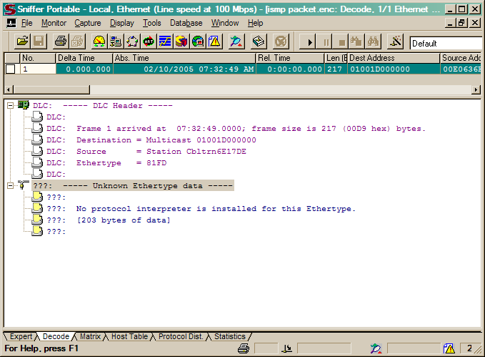
NAI Sniffer Pro v 4.70.553

Slide 3
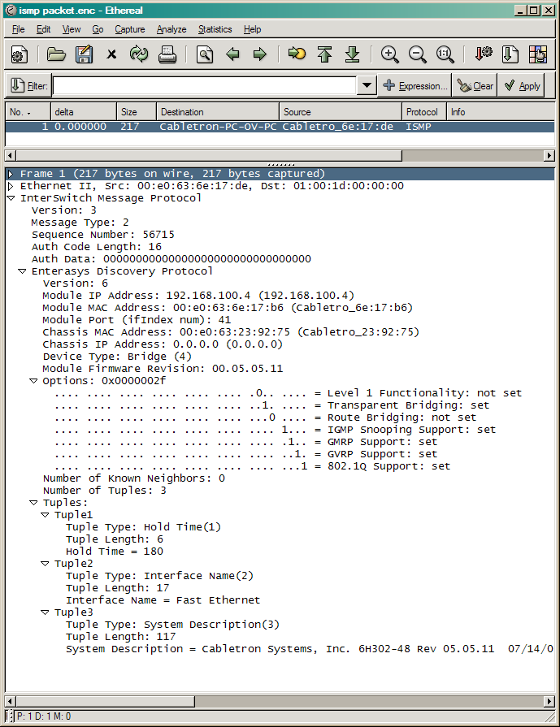
Ethereal v 0.10.5a

Slide 4
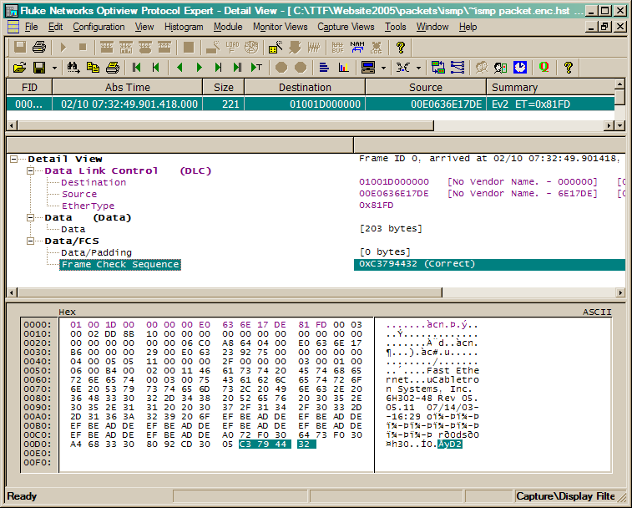
Fluke Optiview Protocol Expert v 6.1.0.13167.0

Slide 5
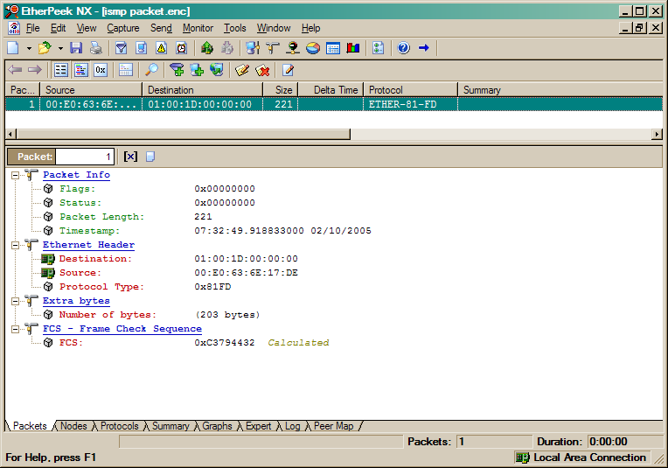
WildPackets Etherpeek NX v3.0.1

